Slide 1
AC-II UNIT 4
DIGITAL TO ANALOG AND ANALOG TO DIGITAL CONVERTERS
Digital-to-analog converters (DAC):Weighted resistor, R-2R ladder, resistor string etc. Analog to-digital converters (ADC): Single slope, dual slope, successive approximation, flash.

Slide 2
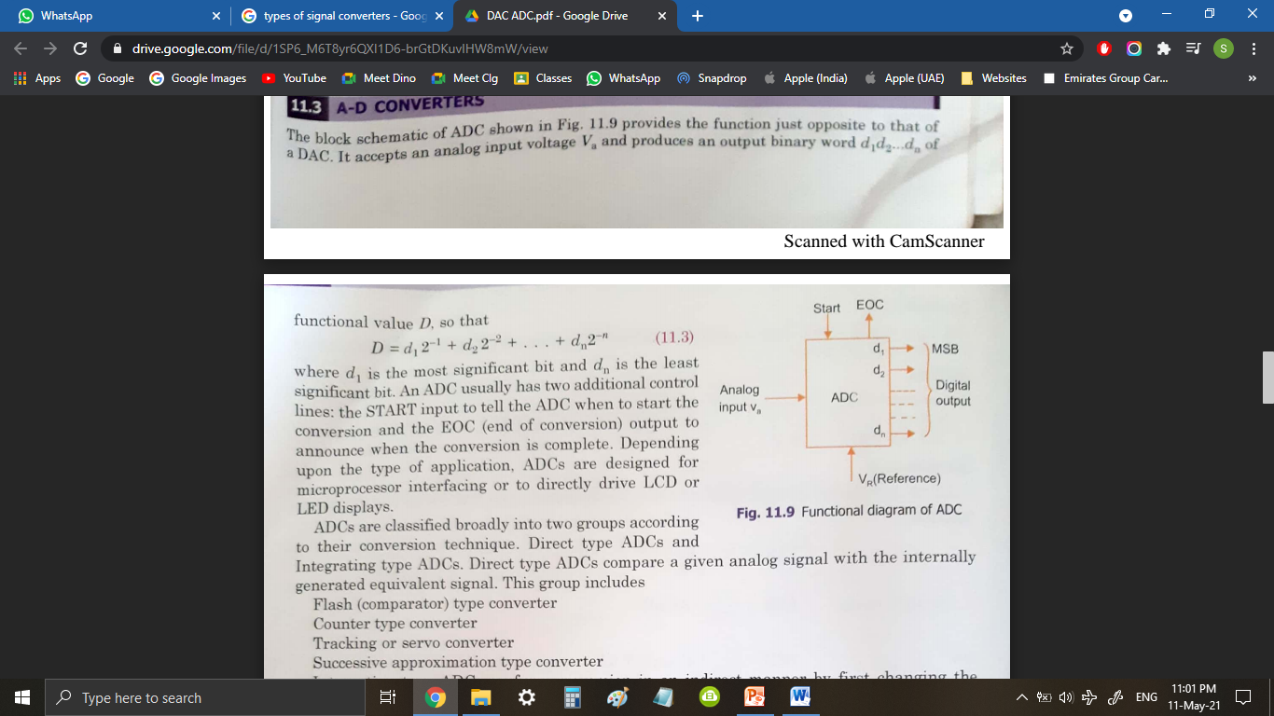
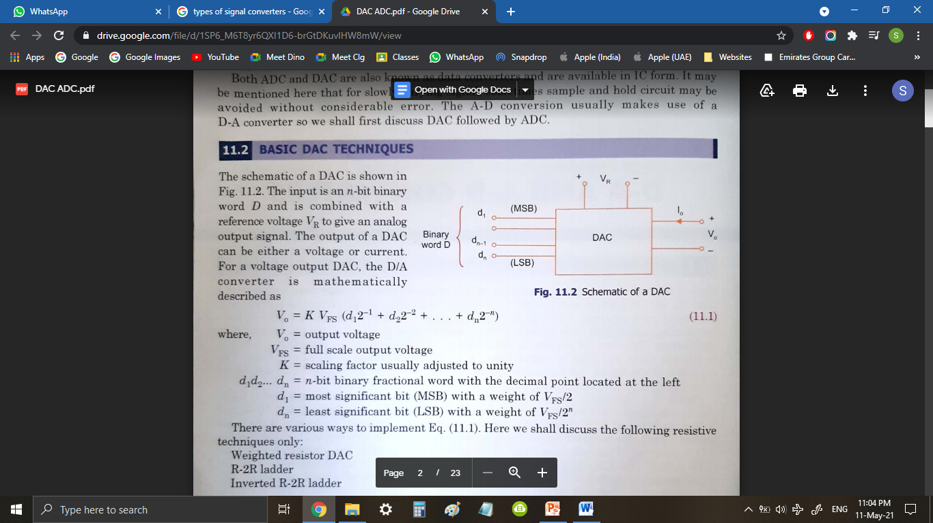
ADC:
Analog to Digital convertors are used to convert Analog Signals to Digital Signals.
DAC:
Digital to Analog convertors are used to convert Digital Signals to Analog Signals.

Slide 3
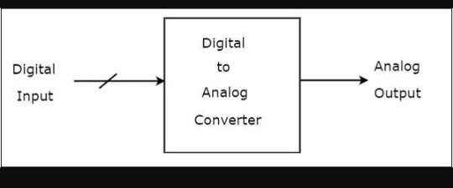
What is DAC?
DIGITAL TO ANALOG CONVERTER - n-bit digital input combined with reference voltage is given as input. It converts digital input into analog signal it can be either voltage or current.
2 TYPES OF DAC:
1. Weighted Resistor DAC
2. R-2R Ladder DAC

Slide 4
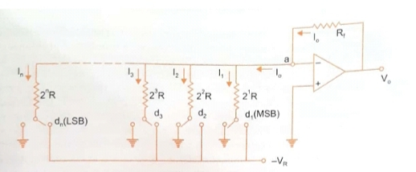
WEIGHTED RESISTOR DAC:

Slide 5
CIRCUIT CONSIST OF:
n switches one for each bit applied to input .
A weighted resistor ladder.
Inverting Summing amplifier that adds the current flowing in resistive network.
Switches will be connected to the ground when the input bits are equal to 0.
Switches will be connected to reference voltage when input bits are equal to 1.
Output voltage is the inverted sum of all input voltages.

Slide 6
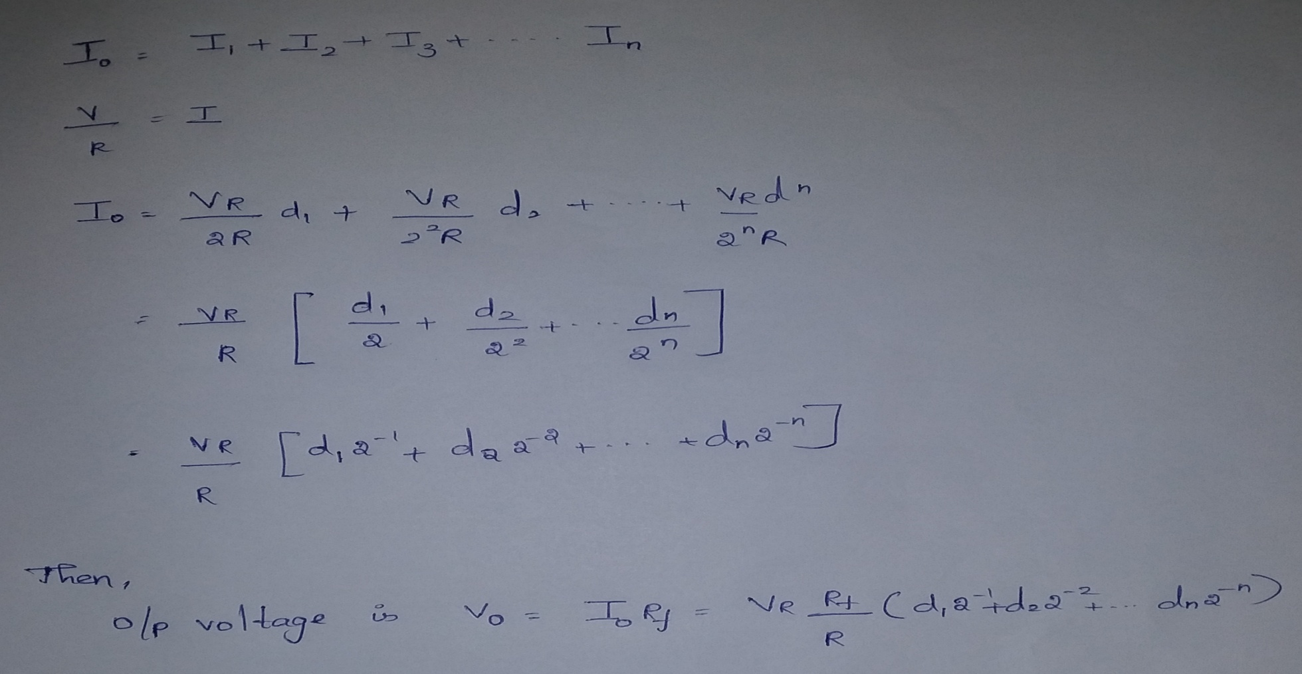
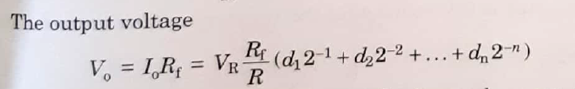
ANALYSIS

Slide 7
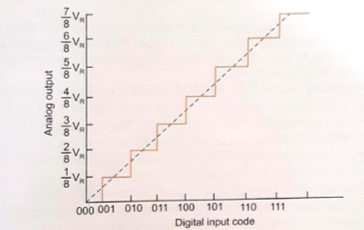
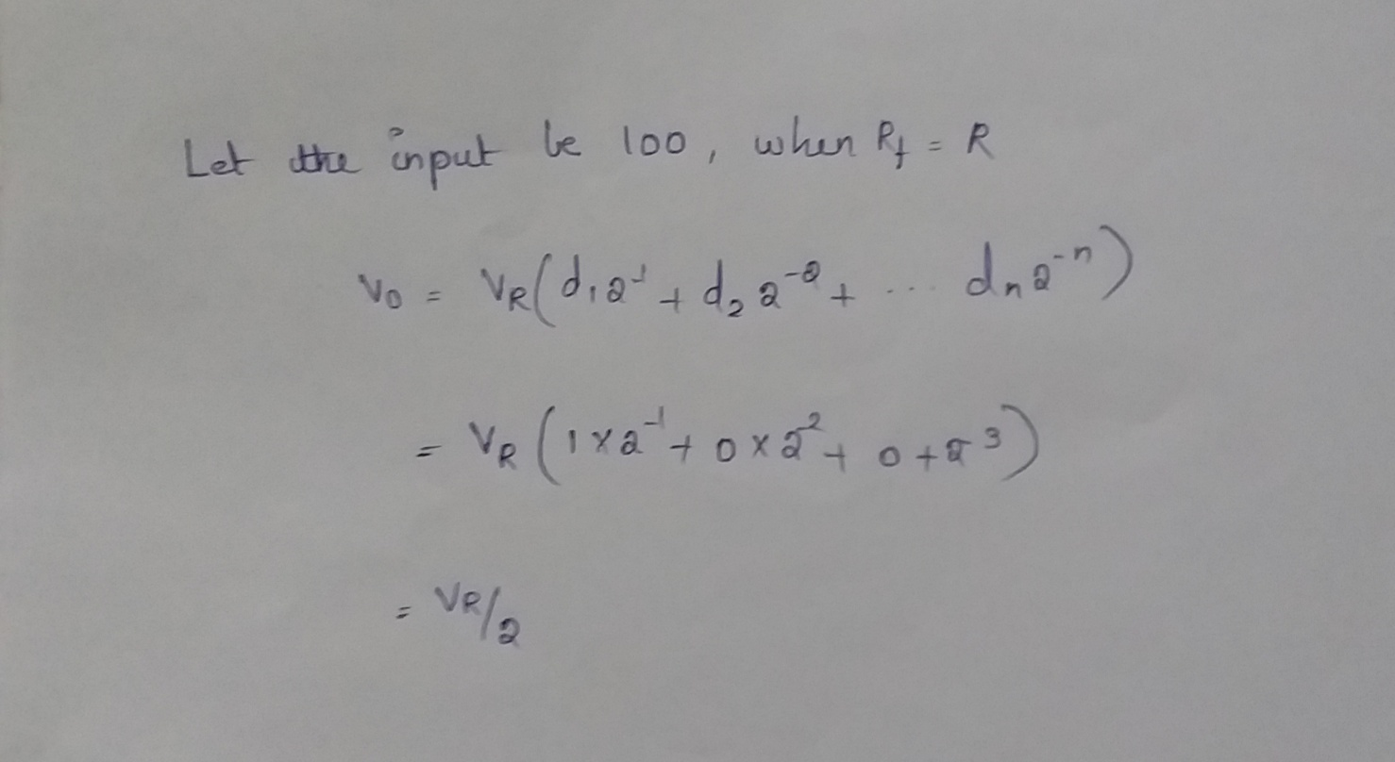
TRANSFER CHARACTERISTICS

Slide 8
DISADVANTAGE:
One of the disadvantages of weighted resistor is the wide range of resistance required .For 8bit DAC the resistance required are 2^0R, 2^1R......2^7R.
The largest resistor is 128 times the smallest one only for 8bit DAC. Fabrication of such IC is not practical.

Slide 9
R-2R DAC
R-2R Digital-to-Analog Converter, or DAC, is a data converter which use two precision resistor to convert a digital binary number into an analog output signal proportional to the value of the digital number.
The R-2R resistive ladder network uses just two resistor values, one which is the base value “R” and the other which has twice the value, “2R” of the first resistor no matter how many bits are used to make up the ladder network.
The typical value of feedback resistor is Rf = 2R. The resistance R is normally selected any value between 2.5 kΩ to 10 kΩ.

Slide 10
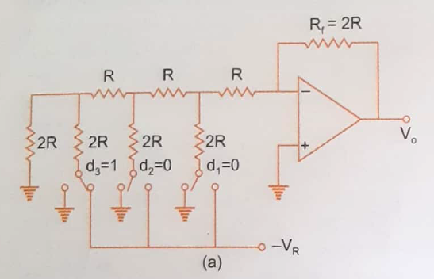

Slide 11
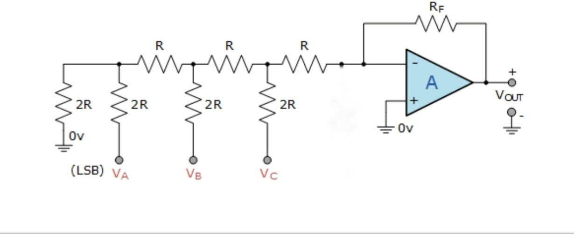
ANALYSIS
2R || 2R → R
(R+R)||2R→ R
…..
2R||R→ 2/3R
(-VR(2/3R))/(2R+2/3R)
➔ -VR/4

Slide 12
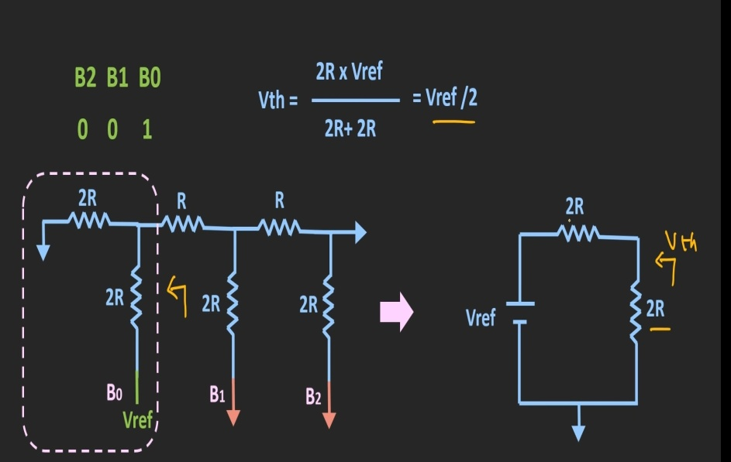
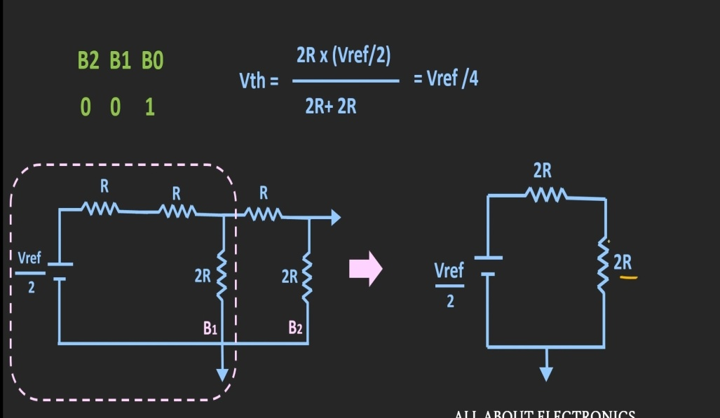
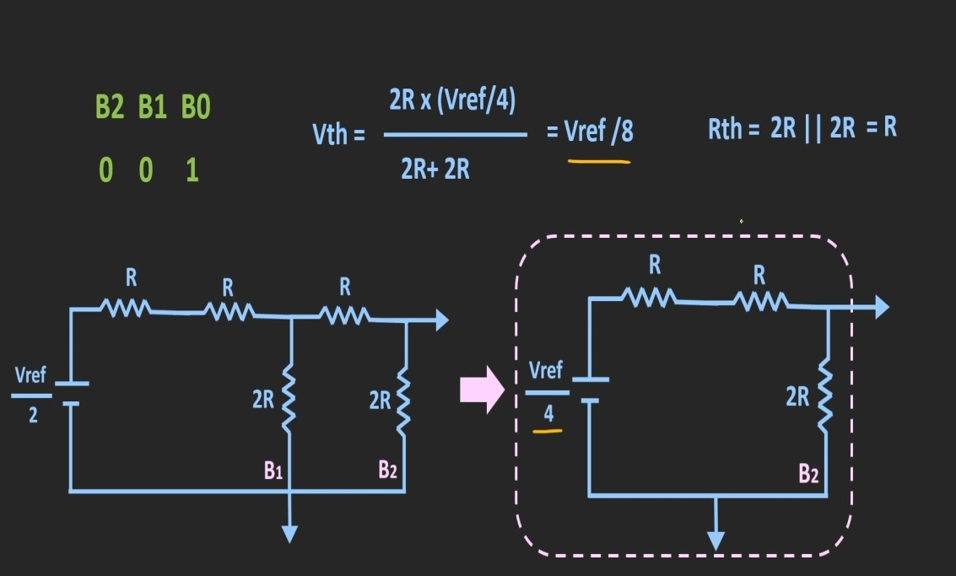
ANALYSIS

Slide 13
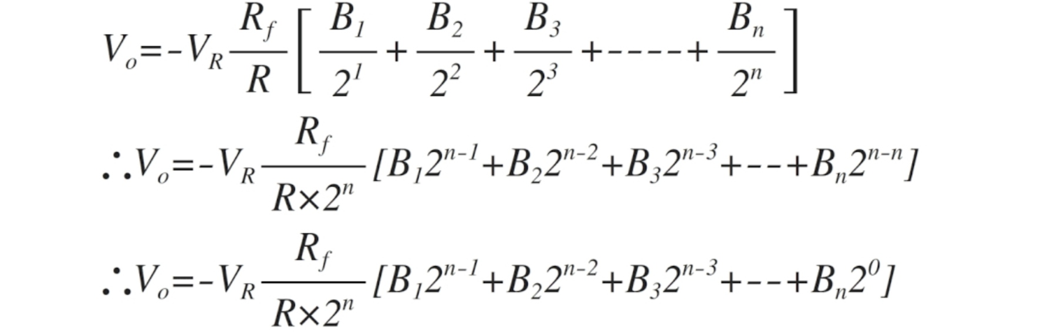
Output voltage:

Slide 14
Resolution: V = 1*VR*Rf/(2^n*R)
ADVANTAGES:
It is inexpensive and as it uses only 2 values of R, accurate fabrication is possible
It is fast and has fixed output impedance ( R ) regardless of number of bits
It is scalable to any desired number of bits
Disadvantages:
In this type of DAC, where there is a change in the input, changes a current flow in the resistor which causes more power dissipation which creates non-linearity in DAC.
With increasing output bits the circuit becomes larger.

Slide 15
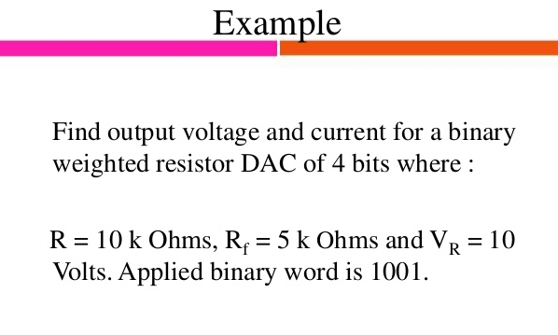

Slide 16
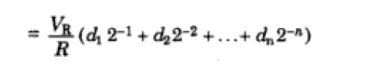
d1d2d3 d4 i/p ----1 0 0 1 Io = 10/10k(1/2 + 0 + 0 + 1/16) Io = 0.0006A Vo = Io Rf = 5.625V
Io

Slide 17
What output voltage would be produced by a D/A converter whose output range is
0 to 10V and whose input binary number is 0100 for a 4 bit DAC?
Output voltage= [(Output range)/2^{n}] x (Decimal equivalent of input binary)
= (10/2^4) * 4
= ?

Slide 18
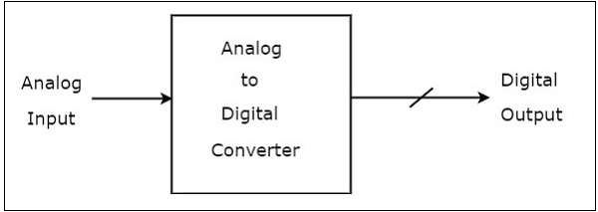
ADC
An Analog to Digital Converter (ADC) converts an analog signal into a digital signal. The digital signal is represented with a binary code, which is a combination of bits 0 and 1.
An Analog to Digital Converter (ADC) consists of a single analog input and many binary outputs. In general, the number of binary outputs of ADC will be a power of two.

Slide 19
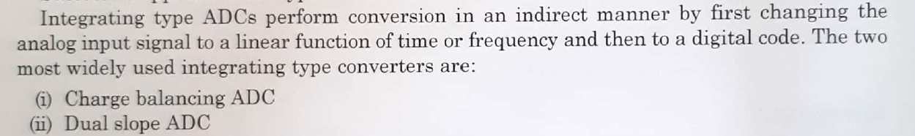
Two types of ADCs:
1. Direct type ADCs
2. Indirect type ADC
1.Direct type ADC:
If the ADC performs the analog to digital conversion directly by utilizing the internally generated equivalent digital (binary) code for comparing with the analog input, then it is called as Direct type ADC.
Counter type ADC
Successive Approximation ADC
Flash type ADC
2. Indirect type ADC

Slide 20
Outline of flash ADC:
Flash ADC is fastest among all ADC.
It takes only one clock cycle to have conversion of analog data into digital data.
It is also called parallel comparator.
Fast conversion speed is accomplished by providing 2^{n}-1 comparators and simultaneously comparing the input signals with unique reference levels
Components of flash ADC:
High speed comparator
Resistive voltage divider
priority encoder

Slide 21
Components of flash ADC:
High speed comparator (2^n -1)
Resistive voltage divider (2^n)
priority encoder (1)
n – desired number of resolution or bits.
For example:
n=3,
comparator=7
resistive voltage divider= 8

Slide 22
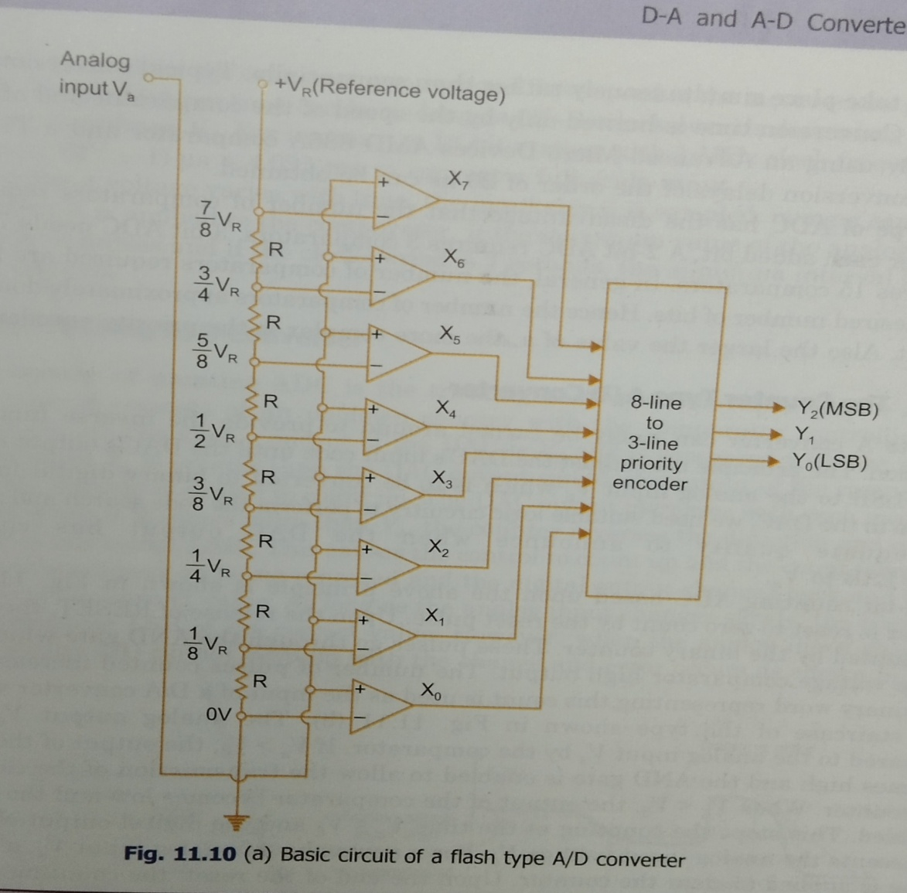
Structure of flash ADC:

Slide 23
Comparator and truth table:
Va
Voltage input | Logic output
Va > Vd | X = 1
Va < Vd | X = 0
Va = Vd | Previous value
+
X
Vd
-
Va – analog voltage
Vd - Reference voltage

Slide 25
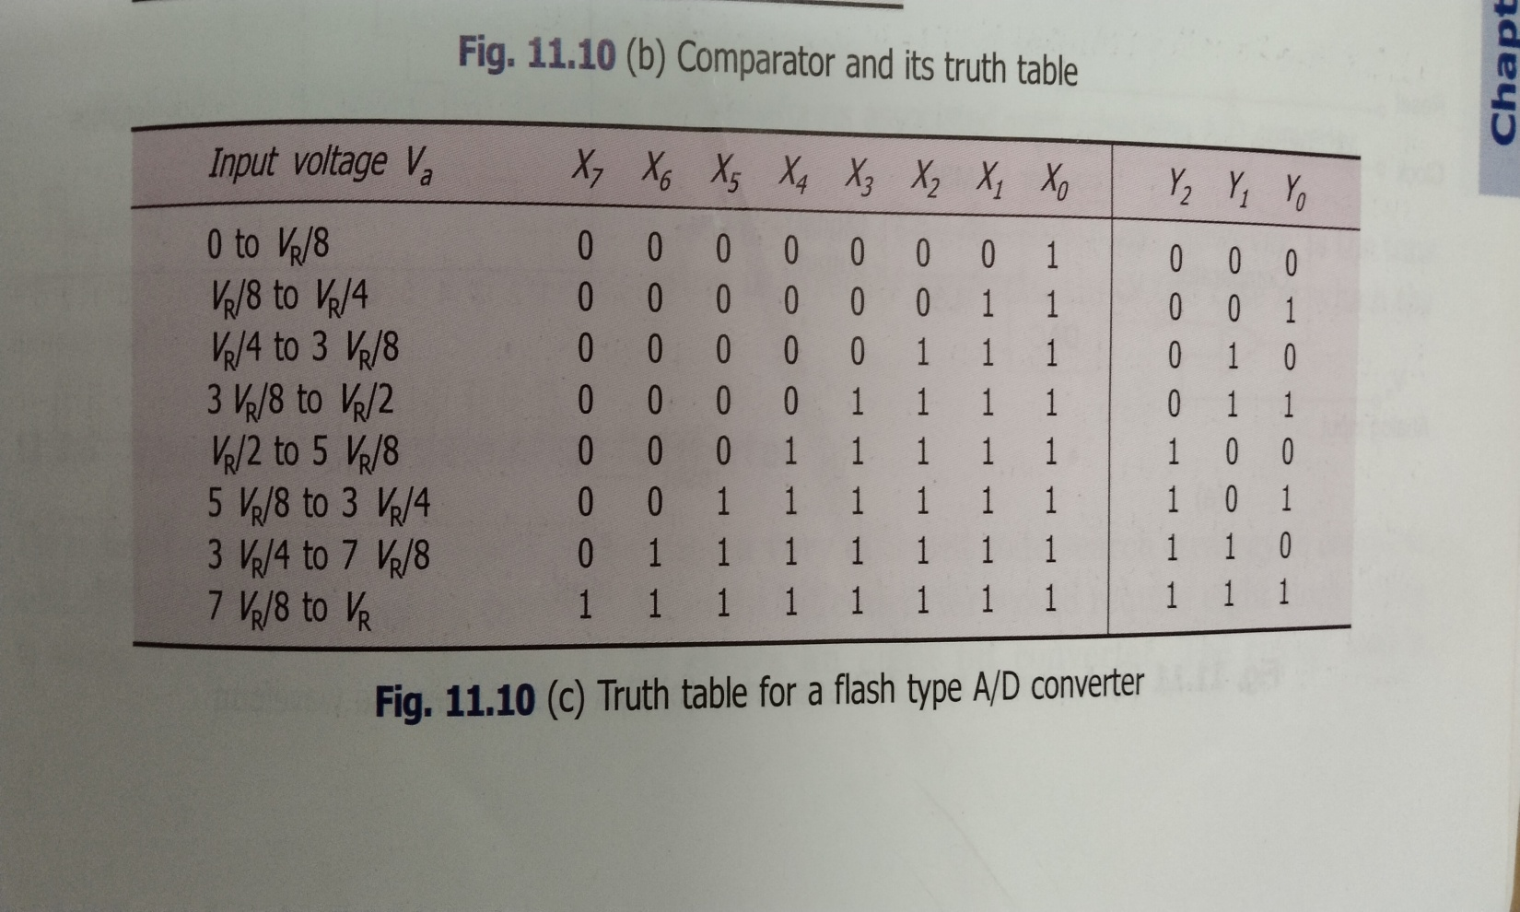
Truth table :

Slide 26
Advantages:
It is fastest ADC( Giga Samples per second)
Useful with large bandwidth input.
Disadvantages:
High power consumption.
Large size due to comparator( for 8 bits 255 comparator are used).
With more comparator need of higher accurate matching network.

Slide 27
Successive Approximation Type ADC
Conversion Time of Counter Type and Tracking Type ADC is depending in Input Analog voltage and Rate of Input Analog Voltage.
Successive Approximation type ADC reduces conversion time and its conversion time does not depends on input Analog voltage.

Slide 28
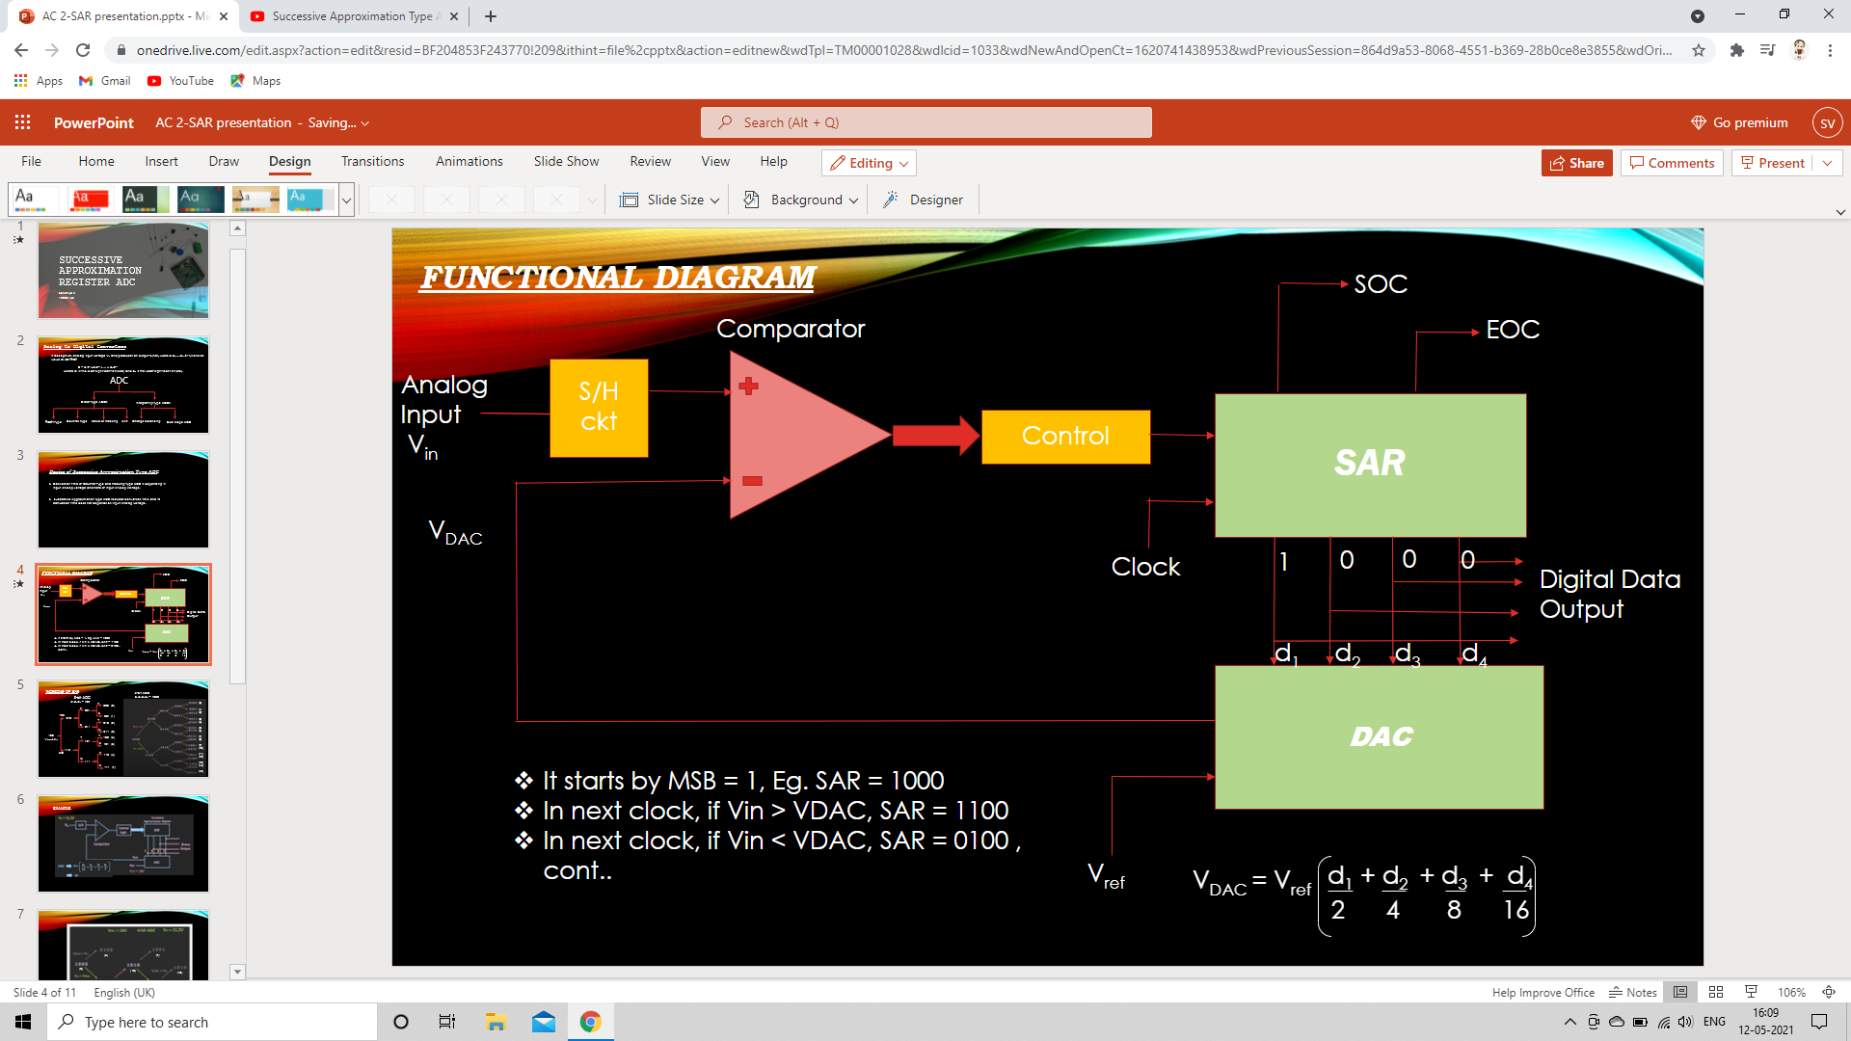
FUNCTIONAL DIAGRAM
SOC
Comparator
EOC
Analog Input
V_{in}
S/H
ckt
SAR
Control
V_{DAC}
Clock
1
0
0
0
Digital Data Output
d₁ d₂ d₃ d₄
DAC
It starts by MSB = 1, Eg.SAR = 1000
In next clock, if V_{in} > V_{DAC}, SAR = 1100
In next clock, if V_{in} < V_{DAC}, SAR = 0100 , cont..
V_{ref}

Slide 29
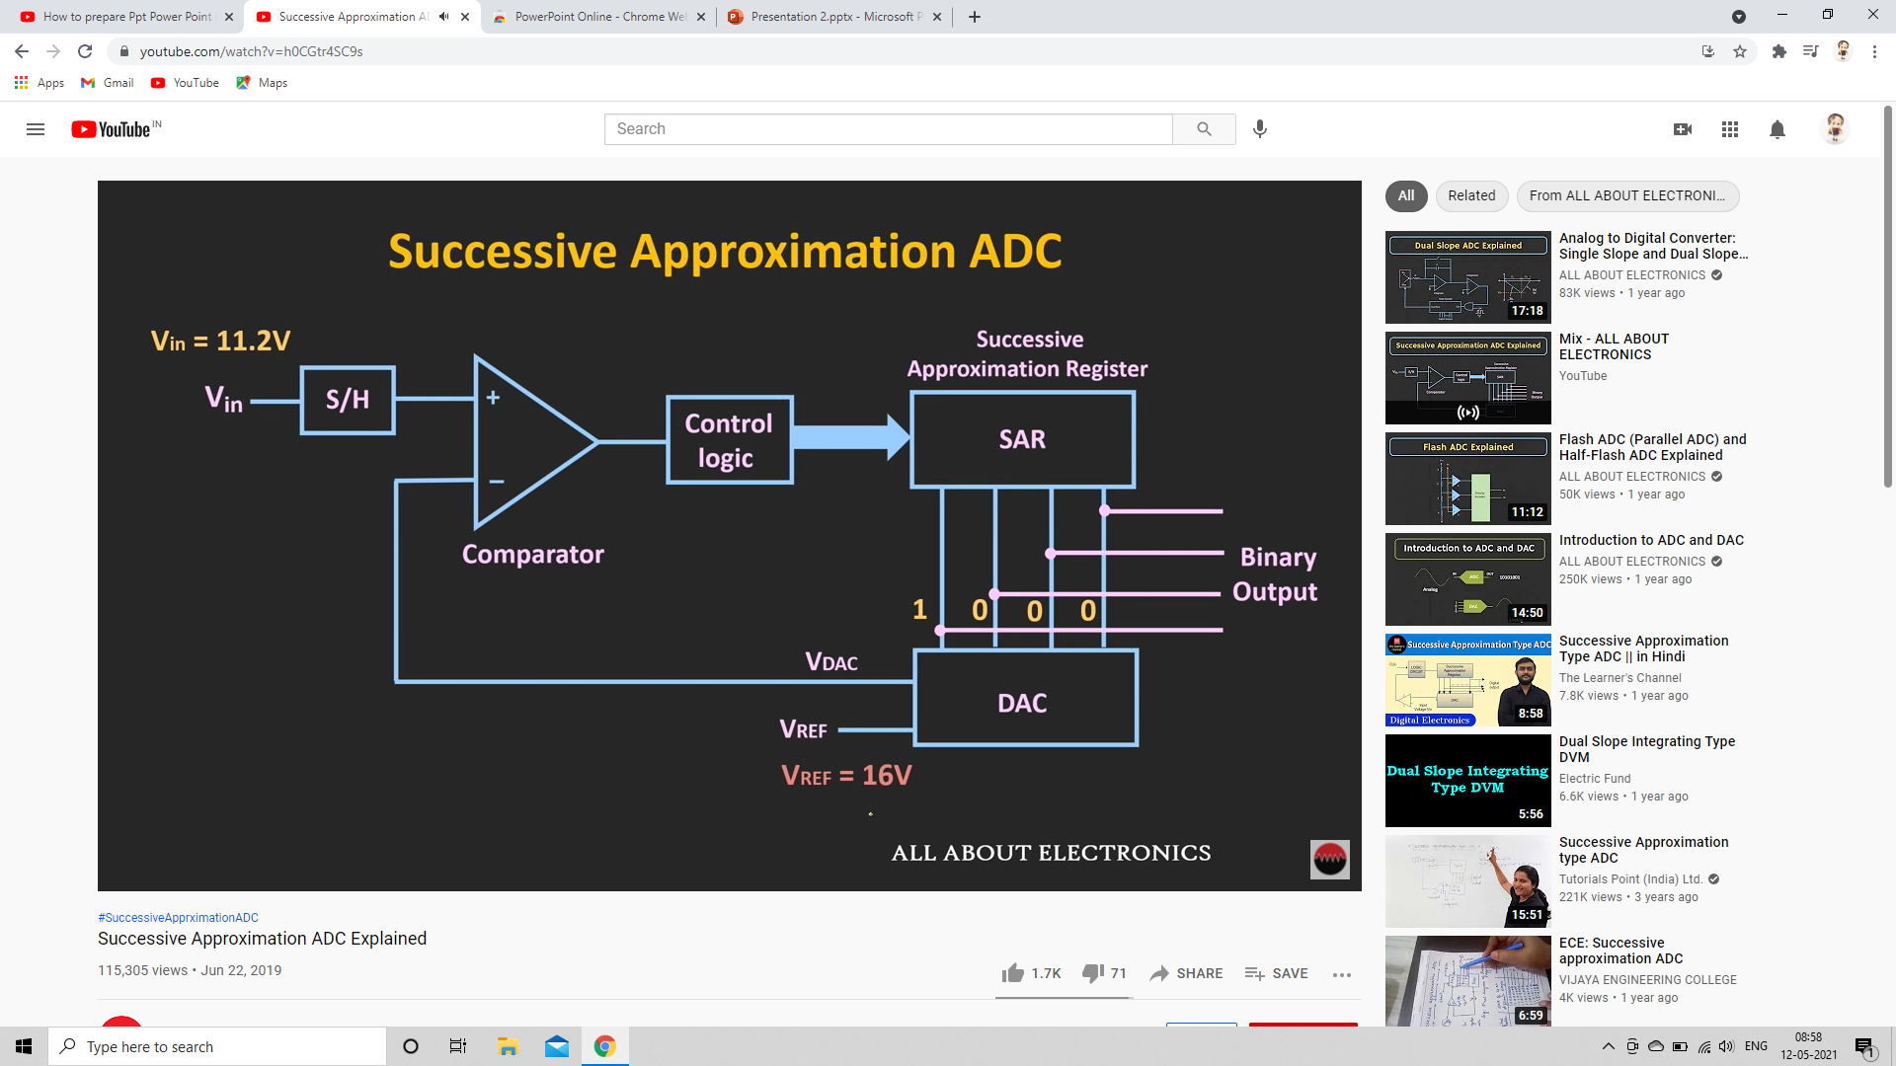
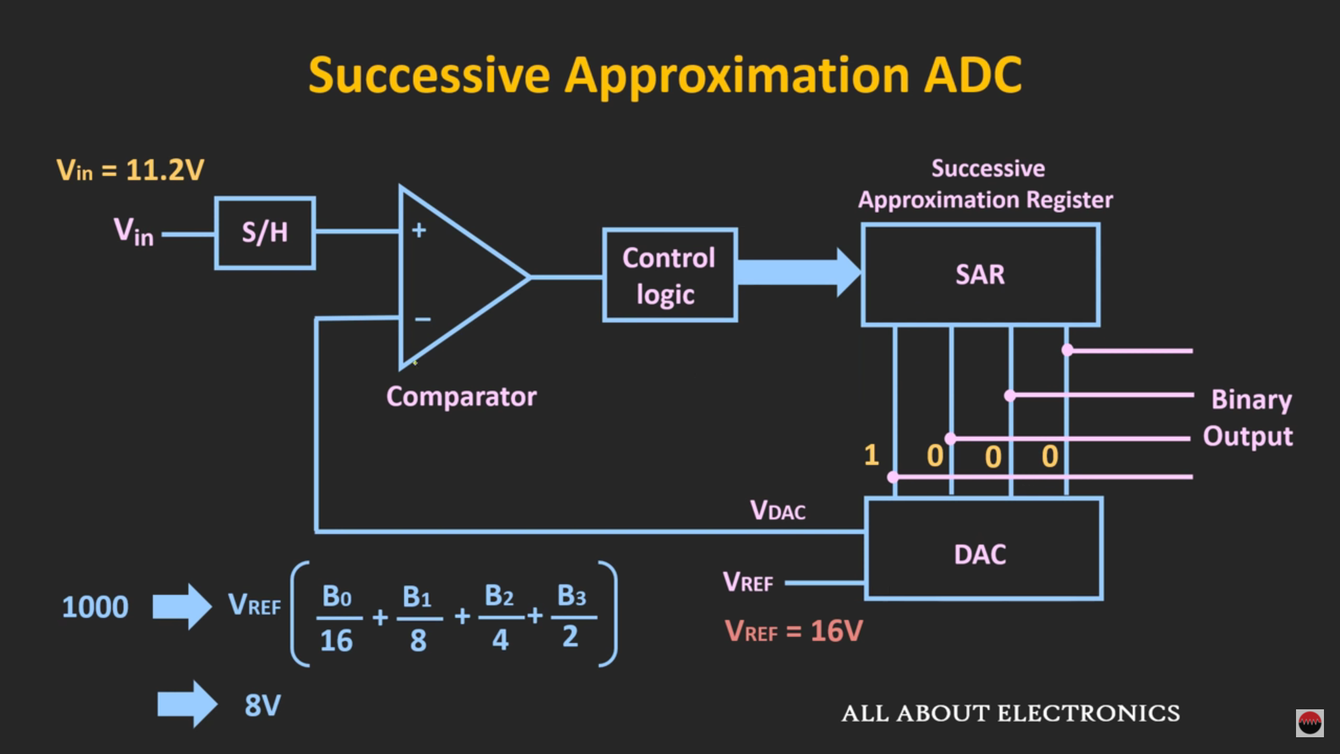
EXAMPLE :

Slide 30
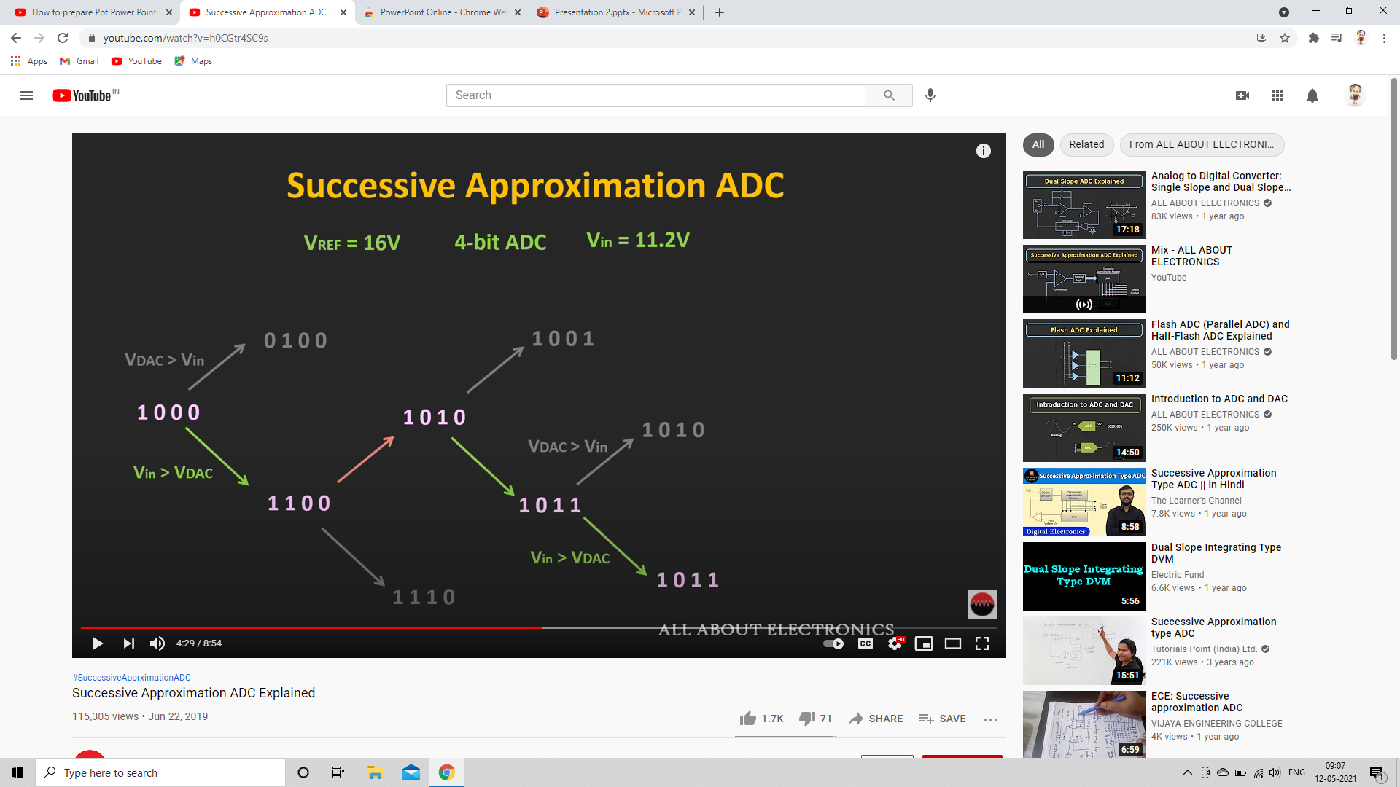
Conversion Tree
(4) (9)
(10)
(11)
(8)
(12)
(10)
(13) (11)

Slide 31
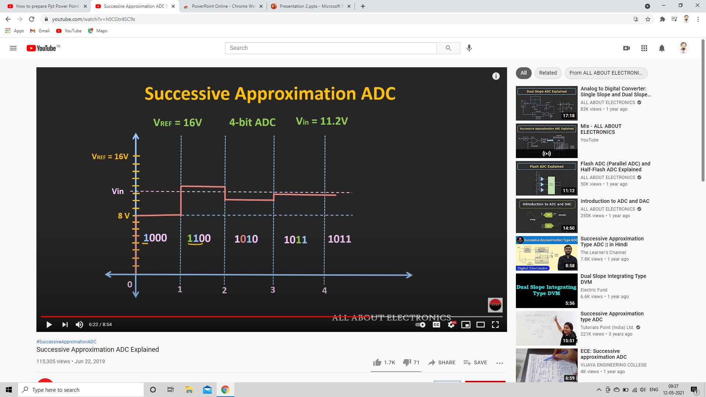
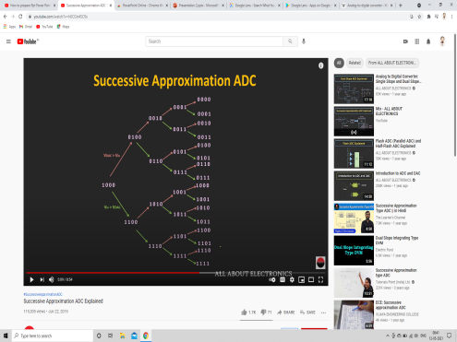
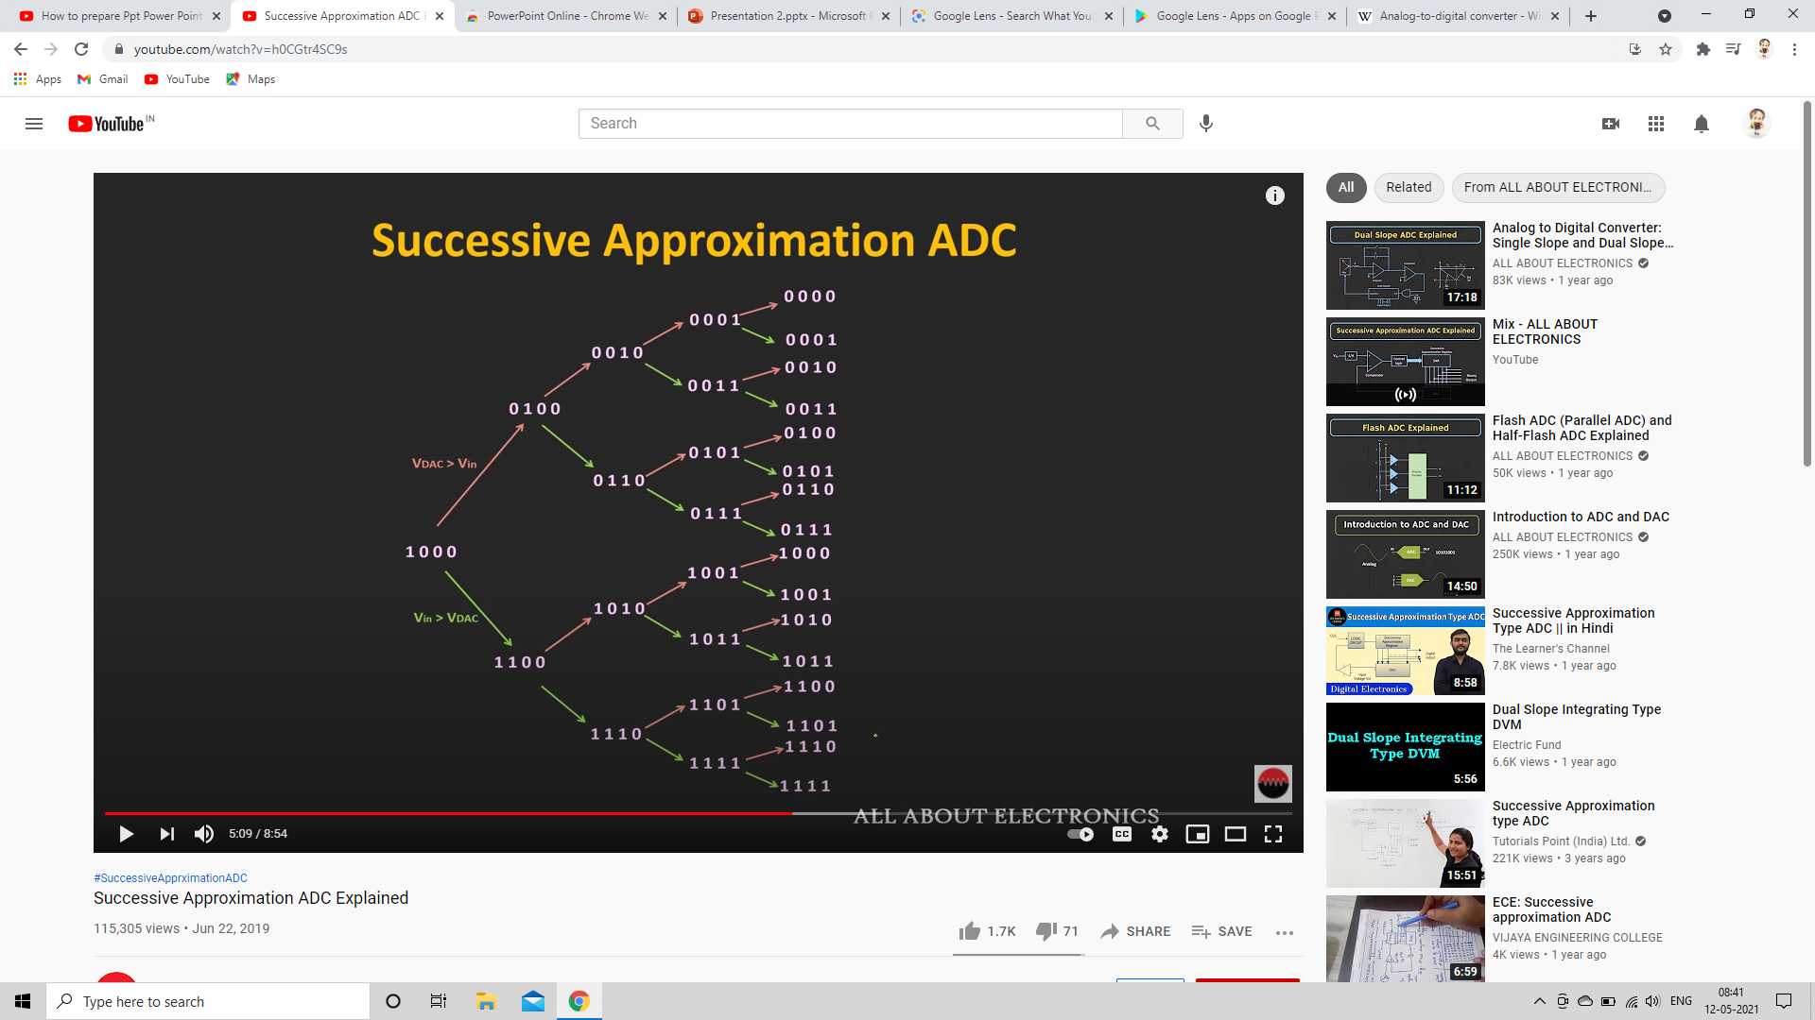
Time Domain

Slide 32
Conversion Time : (Independent of the input voltage)
T_{c} = N T_{CLK}
Resolution : Up to 20 bits (Eg.ADS8900B)
Conversion Speed : Up to 10 Mega Samples per Second(MSPS)
_{(Eg.LTC2368)}

Slide 33
ADVANTAGES OF SAR ADC :
High speed of Conversion
High Accuracy
It uses very efficient code searching strategy called binary search.
Low latency Time
Easy to use

Slide 34
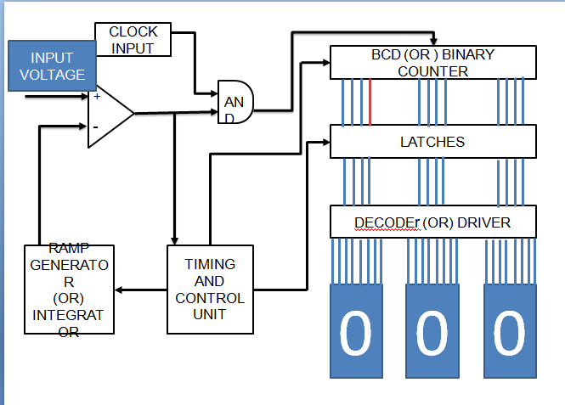
SINGLE SLOPE ADC

Slide 35
COMPARATOR
A comparator is an electronic circuit, which compares the two inputs that are applied to it and produces an output. The output value of the comparator indicates which of the inputs is greater or lesser.
As we here using the non inverting comparator ,let us see the working
INPUT AND REFERENCE VOLTAGE | OUTPUT OF THE COMPARATOR
Vin> V ref | 1
Vin< V ref | 0
Vin = V ref | 0

Slide 36
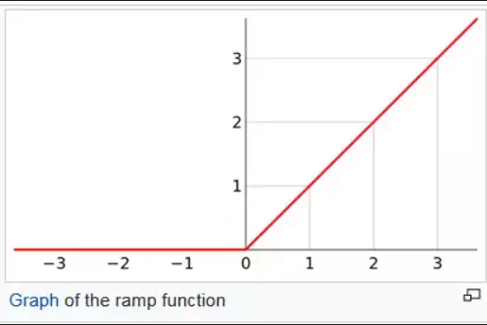
RAMP GENERATOR
A ramp generator is a signal generator which generates a ramp waveform. This waveform increases steadly as the capacitor is being charged until it hits its peak and then decreases even more dramatically as the capacitor is discharged

Slide 37
LET AS TAKE AN EXAMPLE TO GET IDEA OF WORKING
LET Vin = 4V

Slide 38
CLOCK INPUT
INPUT VOLTAGE
BCD (OR ) BINARY COUNTER
1
1
+
1
AND
-
1
LATCHES
Vin > Vref
Comparator ->1
0
DECODES (OR) DRIVER
RAMP
GENERATOR
(OR)
INTEGRATOR
TIMING
AND
CONTROL
UNIT
0
0
0
1

Slide 39

Vin > Vref
Comparator ->1
INPUT VOLTAGE
CLOCK INPUT
BCD (OR ) BINARY COUNTER
1
1
+
1
AND
-
1
LATCHES
1
DECODES (OR) DRIVER
RAMP
GENERATOR
(OR)
INTEGRATOR
TIMING
AND
CONTROL
UNIT
0
0
1
2

Slide 40
Vin > Vref
Comparator ->1
CLOCK INPUT
INPUT VOLTAGE
BCD (OR ) BINARY COUNTER
1
1
+
1
AND
-
1
LATCHES
2
DECODES (OR) DRIVER
RAMP
GENERATOR
(OR)
INTEGRATOR
TIMING
AND
CONTROL
UNIT
0
0
3
2

Slide 41
Vin > Vref
Comparator ->1
CLOCK INPUT
INPUT VOLTAGE
BCD (OR ) BINARY COUNTER
1
1
+
1
AND
-
1
LATCHES
3
DECODES (OR) DRIVER
RAMP
GENERATOR
(OR)
INTEGRATOR
TIMING
AND
CONTROL
UNIT
0
0
4
3

Slide 42
Vin = Vref
Comparator ->0
CLOCK INPUT
INPUT VOLTAGE
BCD (OR ) BINARY COUNTER
1
0
+
0
AND
-
0
LATCHES
4
DECODES (OR) DRIVER
RAMP
GENERATOR
(OR)
INTEGRATOR
TIMING
AND
CONTROL
UNIT
0
0
4
3

Slide 43
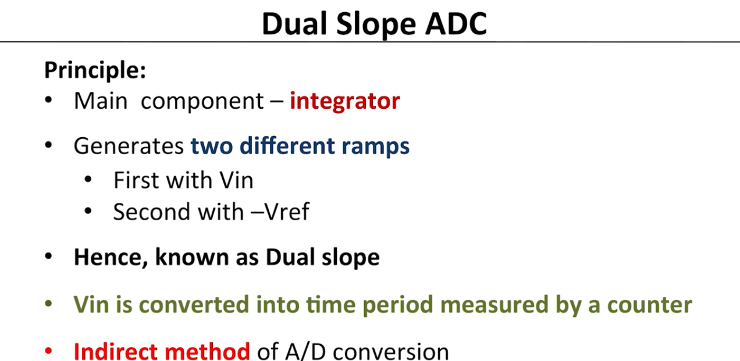

Slide 44
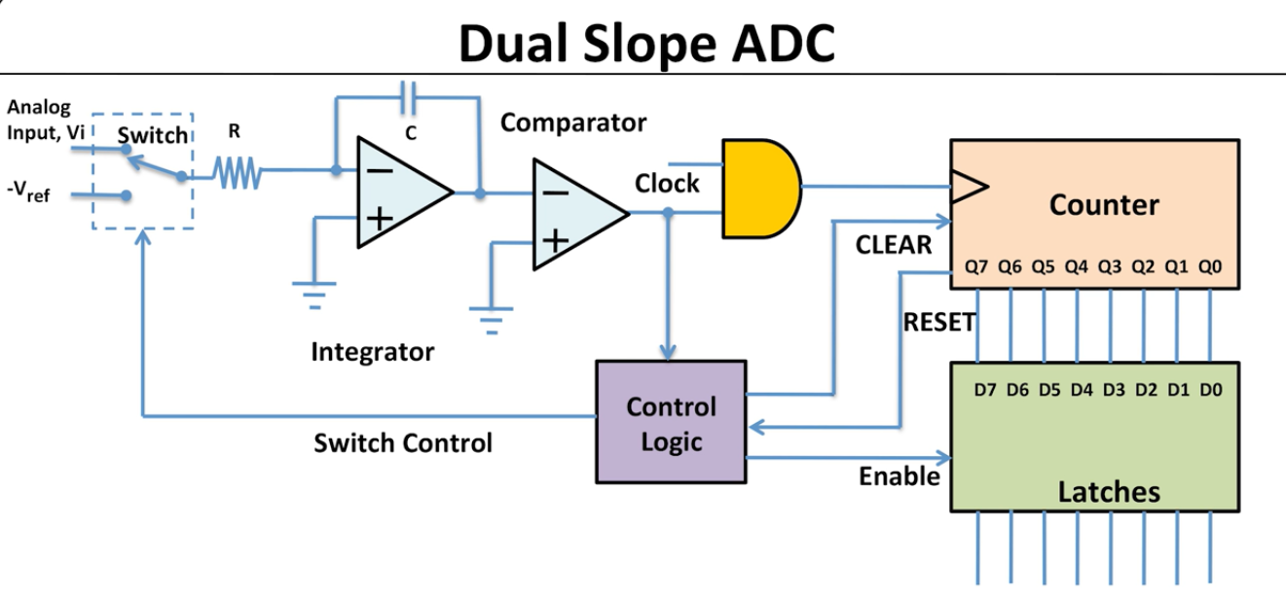

Slide 45
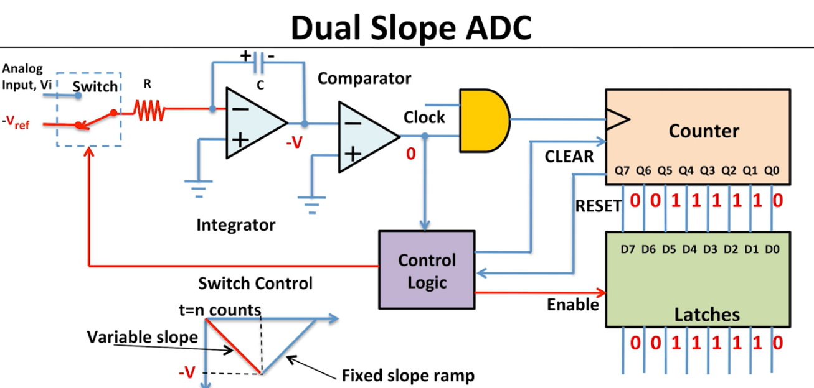

Slide 46
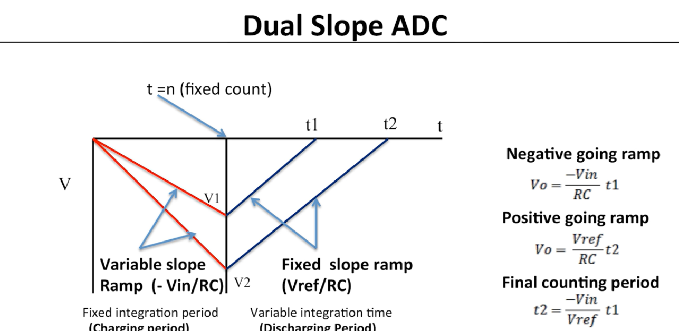

Slide 47
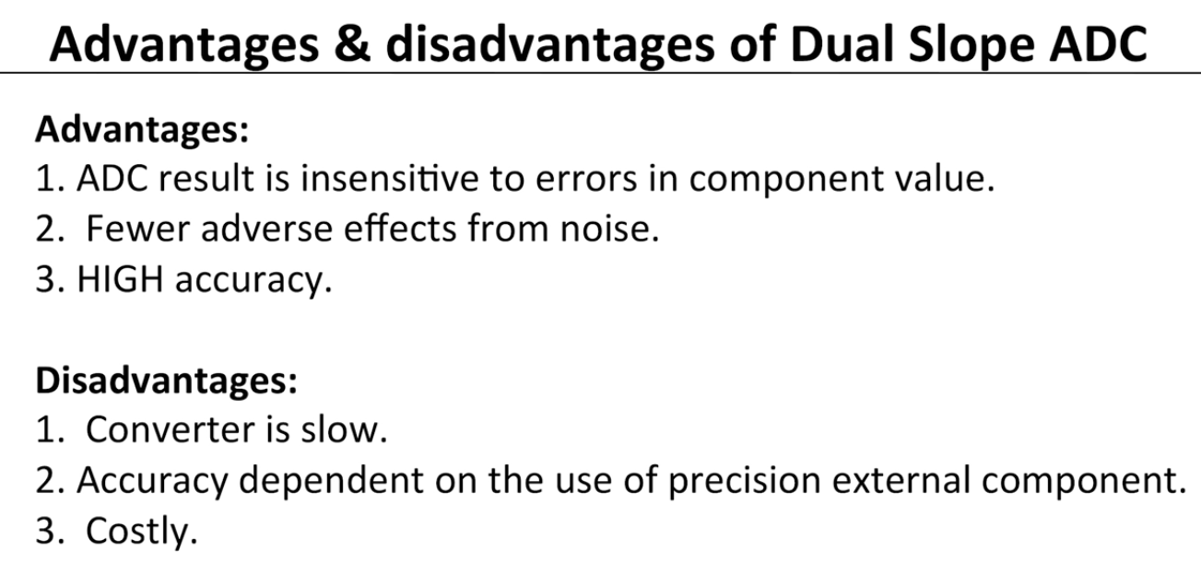

Slide 48
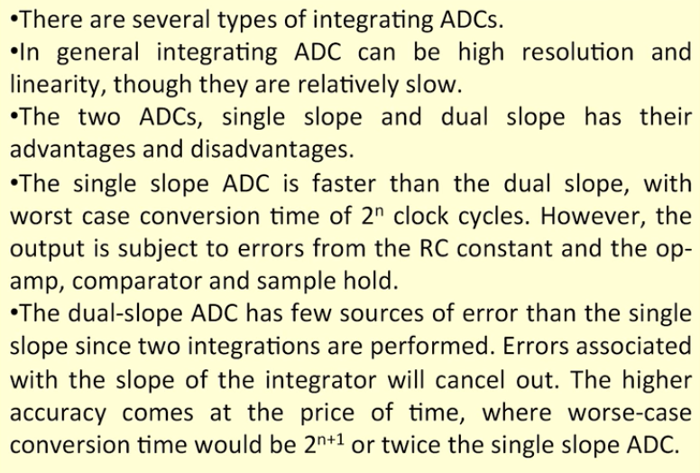
Summary of Single slope and Dual Slope ADC

Slide 49
Thank you

